Slide 1

TSI and College Readiness… it’s not just a cut score!

Slide 2
What is TSI?
Texas Success Initiative
“An institution of higher education shall assess the academic skills of each entering undergraduate student to determine the student’s readiness to enroll in freshman-level academic coursework.”
Current assessment instrument is TSI-A
Placement vs. Entrance
  Developmental Education

Slide 3
Data
Students in Dual Credit
Students that take Developmental Ed Classes

Slide 4
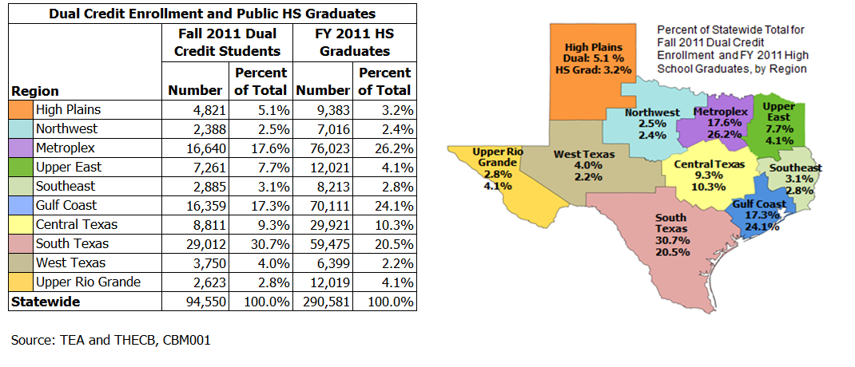
Dual Credit…

Slide 6
2,124 attempted Dual Credit in Region 17 with a 94% success rate.

Slide 7
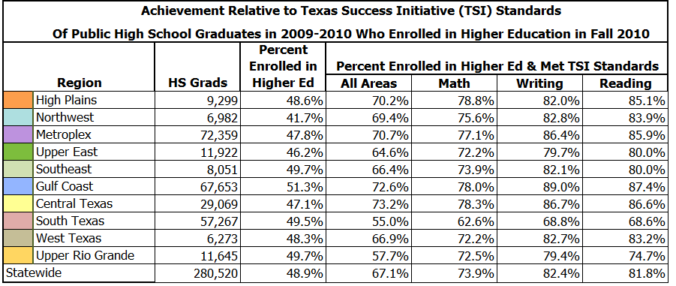
Achievement Relative to TSI…

Slide 8
CRCC - National Data
The Community College Research Center (CRCC) study of 57 community colleges participating in the Achieving the Dream initiative found that only 33 percent of students referred to developmental math and 46 percent of students referred to developmental reading go on to complete the entire developmental sequence (Bailey, Jeong, & Cho, 2008).
Developmental completion rates vary according to remedial level. Only 17 percent of students referred to the lowest level of developmental math complete the sequence; 45 percent of those referred to the highest level complete the sequence (Bailey, Jeong, & Cho, 2008).

Slide 9
CCRC - National Data
A CCRC study of 250,000 community college students found that only 20 percent of students referred to developmental math and 37 percent of students referred to developmental reading go on to pass the relevant entry-level or "gatekeeper" college course (Bailey, Jeong, & Cho, 2008).

Slide 10
CRCC - National Data
Another study using national data found that 58 percent of recent high school graduates who entered community colleges took at least one developmental course. Only about one quarter of these students (28 percent) went on to earn any degree or certificate within 8.5 years (Attewell, Lavin, Domina, & Levey, 2006).

Slide 11
TSI-A
Pre Assessment Activity
Test Design
Seeing students score better on TSI-A than on Accuplacer…more aligned
Essay score of 8 (highest possible)
Over 50% of our fall test takers scored in ABE level in one or more areas
Math & Reading phase in; but Writing stays the same.

Slide 12

What do we know about the new test?
TSI Mathematics & Statistics Test
Multiple choice assessment covering key College and Career Readiness Standards.
Approximately 20 items on placement test and 10 items on diagnostic test

Slide 13
Elementary Algebra and Functions (6 items on placement test; 10 on diagnostic test)
Intermediate Algebra and Functions (9 items on the placement test; 10 items on diagnostic test)
Geometry and Measurement (2 items on placement test; 10 items on diagnostic test)
Data Analysis, Statistics, and Probability ( 3 items on placement test; 10 items on diagnostic test)

Slide 14

TSI-Writing Test
Multiple choice assessment covering key College and Career Readiness Standards
Approximately 20 items on placement test, and 10-12 items on the diagnostic test.

Slide 15

Essay Revision- 8 items on placement test; 12 items on diagnostic test
Agreement- 3 items on placement test; 10 items on diagnostic test**
Sentence Structure- 5 items on placement test; 10 items on diagnostic test
Sentence Logic- 4 items on placement test; 10 items on diagnostic test

Slide 16

TSI Reading Test
Multiple choice assessment covering key College and Career Readiness Standards
Approximately 24 items on placement test; 10-12 items per category on the diagnostic test.

Slide 17

Literary Analysis-4 items on placement test; 12 items on diagnostic test
Main Idea and Supporting Details-5 items on placement test; 10 items on diagnostic test
Inferences in a text or texts- 8 items on placement test; 10 items on diagnostic test
Author’s use of language-7 items on placement test; 10 items on diagnostic test

Slide 18

WritePlacer
Write essay that “demonstrates clear focus, the logical development of ideas in well-organized paragraphs, and the use of appropriate language that advances the author’s purpose.”

Slide 19

Evaluates Six Dimensions
Purpose and Focus-extent to which presents information in a unified and coherent manner
Organization and Structure-extent to which writer connects orders and connects ideas
Development and Support- extent to which writer develops and supports ideas
Sentence Variety and Style- extent to which writer crafts sentences and paragraphs demonstrating control of vocabulary, voice, and structure

Slide 20
Mechanical Conventions-extent to which the writer expresses ideas using standard English
Critical Thinking-extent to which the writer communicates a point of view and demonstrates reasoned relationships among ideas.

Slide 21
TSI Testers--What Are We Seeing?
Those that are compliant are in testing lab about 3 hours
Dual Credit students are doing very well on TSI
Have had students stay all day

Slide 22
Current TSI Exemptions…
ACT Composite Score 23 Math 19 ELA 19
SAT Composite Score 1070 Math 500 ELA 500
TAKS Exit Level ELA 2200 & 3 on essay, Math 2200
EOC Algebra 2 Level 2 Final Phase In (4000)
EOC English 3 Level 2 Final Phase In (4000)
  Exemptions are good for 5 years.

Slide 23
Testing to Satisfy TSI
TSI Assessment (TSIA) Current Scores*
  Math 350
  Reading 351
  Writing 363 & 4 on essay of
      5 or better on essay
      Scores change in 2017 & 2019

Slide 24
TSI Assessment-Are You Ready?
More flexibility
More cost effective
  $11 vs. $30+
Contact College Board at (866) 607-5223
Contact Juli Wood at (806) 716-2367 or jwood@southplainscollege.edu.

Slide 25
Workforce Dual Credit
Examples: Cosmetology, Welding, CNA and EMSP
TSI Restricted or Waived
Certificate Programs ≤ 42 credit hours are TSI waived

Slide 26
College Board TSI Information
http://accuplacer.collegeboard.org/students/prepare-for-accuplacer
Free TSI Sample Questions
Free TSI Sample Essays
I-Phone App $1.99
Web-based Study App $2.99

Slide 27
Using TSI to determine College Prep Course needs…
HB 5 Requirement

Slide 28
College Preparatory Course Rule
(Proposed May 16, 2014)
A student who successfully completes a college preparatory course under Texas Education Code §28.014 is exempt for a period of twelve (12) months from the date of high school graduation with respect to the content area of the course. This exemption applies only at the institution of higher education that partners with the school district in which the student is enrolled to provide the course. Additionally, an institution of higher education may enter into a Memorandum of Understanding with a partnering institution of higher education to accept the exemption for the college preparatory course.

Slide 29
MOU Requirements:
Student Eligibility Requirements
To be eligible for enrollment in a college preparatory mathematics and/or English language arts course the student did not meet Texas Success Initiative (TSI) Exemption standards as defined in TAC19.1.4D Rule §4.85 and in TEC Sec. 28.014.

Slide 30
School District MOU’s
MOU’s for teaching these college preparatory courses have been distributed to school districts.
Districts need to sign & return MOU which specifies SPC requirements for students to gain successful completion in the courses.

Slide 31
Location, Size and Student Composition of Classes
Courses will be conducted at the high school with the high school administration being responsible for designating the instructor and the times for the courses to be taught on the campus.

Slide 32
What Does This All Mean?
Importance of Advising
  Help Students Sequence Courses due to semester course hour limits
  Help Students Choose Appropriate Courses
  Get Students TSI Compliance Early

Slide 33
Impact on Accountability…
Index 4 College Readiness Indicator
  2014-2015 TAKS Scores of 2013-2014 Seniors
  2015-2016 ACT/SAT, TSI, STAAR*

Slide 34
Readiness vs. Eligibility
More students are going to college than ever before and this trend is likely to continue
Two-year colleges have seen a noticeable enrollment increase
Readiness and eligibility are two different goals
© 2012 Texas College & Career Readiness Center
Notes:
Directions for Presenter: Italics
Information for Presenter to Convey: Bold
Presenter’s Notes:
The proportion of students going on to postsecondary education has steadily increased over the past 100 years and is likely to continue to increase.
Two-year college have seen an especially noticeable enrollment increase.
Current administration and many of the trends in education policy use the rhetoric of college and career readiness, which is important, but we have to understand that college and career readiness is not the same as college eligibility and should be treated as a different goal.
The following slides will spend some time describing the big picture.

Slide 35
Texas Statewide Postsecondary Enrollment by Institution
(2006-2010)
*Headcount only includes students enrolled in credit-bearing classes
Source: THECB. (2011). Texas higher education: Statewide longitudinal enrollment.
Notes:
Directions for Presenter: Italics
Information for Presenter to Convey: Bold
Presenter’s Notes:
Point out the increase in going to college.
When we talk about college and career readiness there are many interpretations. In Texas, we use the word “college” broadly and what is not shown on this slide are other options for further study that leads students to high skill, high wage, high demand occupations. Any further study beyond high school is considered “college” for the use of this Guide.
Source: THECB. (2011). Texas higher education: Statewide longitudinal enrollment.

Slide 36
A Need in Texas
What makes a student college and career ready?
Who are the students responsible for these increasing numbers?
How are they different than students of the past?
What are the needs of this new population?
© 2012 Texas College & Career Readiness Center
Notes:
Directions for Presenter: Italics
Information for Presenter to Convey: Bold
Presenter’s Notes:
While most schools in Texas share agreement about the importance of college and career readiness, most do not share an accurate understanding of what makes a student successful in postsecondary education.
Getting more students ready for college means succeeding with an increasingly challenging student population, one that needs the opportunity.
More students are first-generation college attenders, a population we know to be vulnerable and in need of support.
Globalization and labor market changes demand students enter the workforce college and career ready.

Slide 37
Of 100 9th graders, how many…
Source: NCES – Common Core Data, IPEDS Residency and Migration Survey, IPEDS Enrollment Survey, IPEDS Graduation Rate Survey (2008)
Notes:
Directions for Presenter: Italics
Information for Presenter to Convey: Bold
Presenter’s Notes:
Specifically point out each bar graph showing Texas’ position as compared to Best-Performing State’s and the nation in the four categories.
This chart shows the top performing states from left to right. More students are going to college, but what happens when they get there? More students are arriving unprepared and, as this slide reveals, not persisting toward degree completion.
The U.S. Department of Education states that today’s young people will need to be better educated and prepared as the US continues to move toward a knowledge/information-based economic model. In the past, a high school education was enough to land a job that offered stability and benefits. The current economic climate is such that completing a degree or certificate program is critical.
Source: NCES – Common Core Data, IPEDS Residency and Migration Survey, IPEDS Enrollment Survey, IPEDS Graduation Rate Survey (2008)

Slide 38
Percentage of Adults with an Associates Degree or Higher by Age
WORLD: ■ 55-64 ▲ 25-34
TEXAS: ■ 45-64 ▲ 25-34
Sources: Organization for Economic Co-operation and Development. (2009). Education at a glance. US Census Bureau. (2009). American community survey.
Notes:
Directions for Presenter: Italics
Information for Presenter to Convey: Bold
Presenter’s Notes:
Presenter may allow participants to comment on the data and reinforce the need for college and career readiness.
This slide represents the international context in which college and career readiness must be viewed. The blue arrows represent young people entering the work force world-wide. The red squares represent older workers preparing to leave the workforce. As you can see, in almost every country, the percentage of young people entering the workforce with an Associate’s degree or higher far exceeds the number of workers leaving the work force. Take special note of South Korea.
Now, the purple arrow represented young people entering the work force in Texas and the green square represents the workers approaching retirement. As you can see, Texas is flipped. Young people are entering the workforce with lower educational attainment than the generation who is nearing retirement. The workforce being produced by Texas is not competitive with much of the rest of the world and the rate at which we are replacing retired workers with better educated workers is markedly lower.

Slide 39
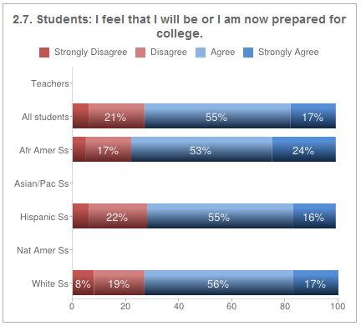
Consider this data…
Source: Texas HS Snapshot College Readiness Survey Summary data with 19, 505 students and 37 different high schools represented.
Notes:
Directions for Presenter: Italics
Information for Presenter to Convey: Bold
Presenter’s Notes:
Hundreds of Texas schools have used the Campus Snapshot or a diagnostic tool for school improvement. The Campus Snapshot consists of a team of specialists that conduct classroom observations, interviews, and surveys. This slide shows data from a survey question that has been completed by over 2,000 Texas students.
Have participants discuss this data and whether they feel these statistics hold true for their school. If their students do not report being ready for college and careers, what reasons do they think might explain these responses?
Source: Texas HS Snapshot College Readiness Survey Summary data with 19,505 students and 37 different high schools represented.

Slide 40
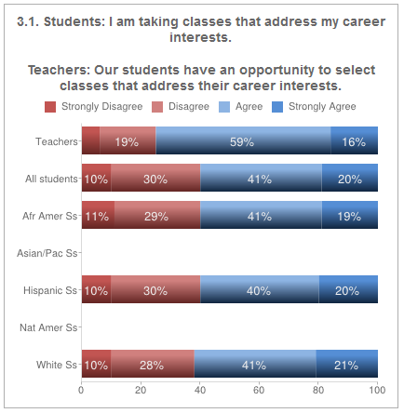
Consider this data…
Notes:
Directions for Presenter: Italics
Information for Presenter to Convey: Bold
Presenter’s Notes:
There are still large numbers of students who do not see a connection to what they want to achieve from school and what courses they are taking at school.
This is another Campus Snapshot data set that provides information as to course taking. You may engage participants by asking if this data mirrors schools they know.

Slide 41
Building a College and Career Readiness Foundation
Notes:
Directions for Presenter: Italics
Information for Presenter to Convey: Bold
Presenter’s Notes:
Ask participants to take out their Profile Planning Guide and familiarize themselves with it.
Handout:
Profile Planning Guide

Slide 42
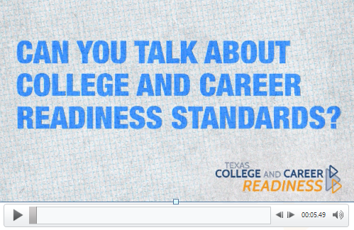
Accountability and College and Career Readiness
Notes:
Directions for Presenter: Italics
Information for Presenter to Convey: Bold
Presenter’s Notes:
Participants will view brief video presentation, which addresses key accountability aspects tied to college and career readiness.
Ed Vara is Deputy Director of Academic Services at Education Service Center, Region XIII.
Click on the video to launch “Accountability and College Career Readiness.”
College and career readiness is directly tied to state accountability measures.

Slide 43
Building a College and Career Ready Culture
Establishes a conceptual framework
Establishes a shared understanding
Notes:
Directions for Presenter: Italics
Information for Presenter to Convey: Bold
Presenter’s Notes:
The Profile Planning Guide is grounded in research.
The first step in the process is to familiarize the school leadership team with the conceptual framework upon which this process was built.
Doing so allows all users to move forward with a shared understanding of college and career readiness.

Slide 44
Building a College and Career Ready Culture
There are three primary research based concepts:
  The Four Keys to College and Career Readiness
  The Texas College and Career Readiness Standards
  The Seven Principles of College and Career Readiness
Notes:
Directions for Presenter: Italics
Information for Presenter to Convey: Bold
Presenter’s Notes:
It was essential to the statewide taskforce that all information within the Profile Planning Guide tie to current research and best practices.

Slide 45

Think about…
What is your district/campus already doing?
What is going right?
Notes:
Directions for Presenter: Italics
Information for Presenter to Convey: Bold
Presenter’s Notes:
Engage your audience.
Find out what the audience is already doing to improve college and career readiness.
Inquire about the kind of support they feel they need.
Acknowledge what they are doing right.
Do these things before moving into discussion of how the tool aligns to their needs or what they may not be doing.

Slide 46
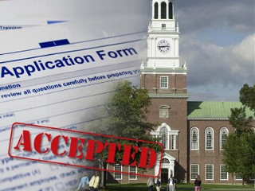

Mind Shift 1: Promotion
Notes:
Counting college enrollment rates as a measure of high school success verses graduation.

Slide 47
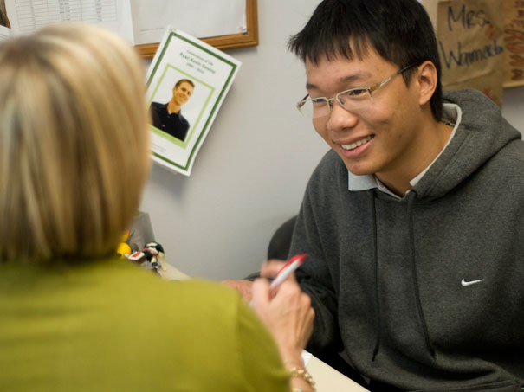

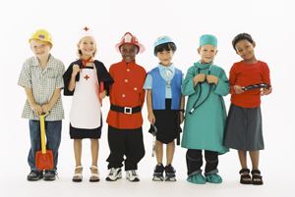
Mind Shift 2: Counseling
Notes:
Post-Secondary guidance is for all students.
“Guidance Counselor Only” model to a guidance counselor plus teacher-engaged effort to encourage college-going
College and career guidance is essential in the K-12 comprehensive guidance curriculum.

Slide 48
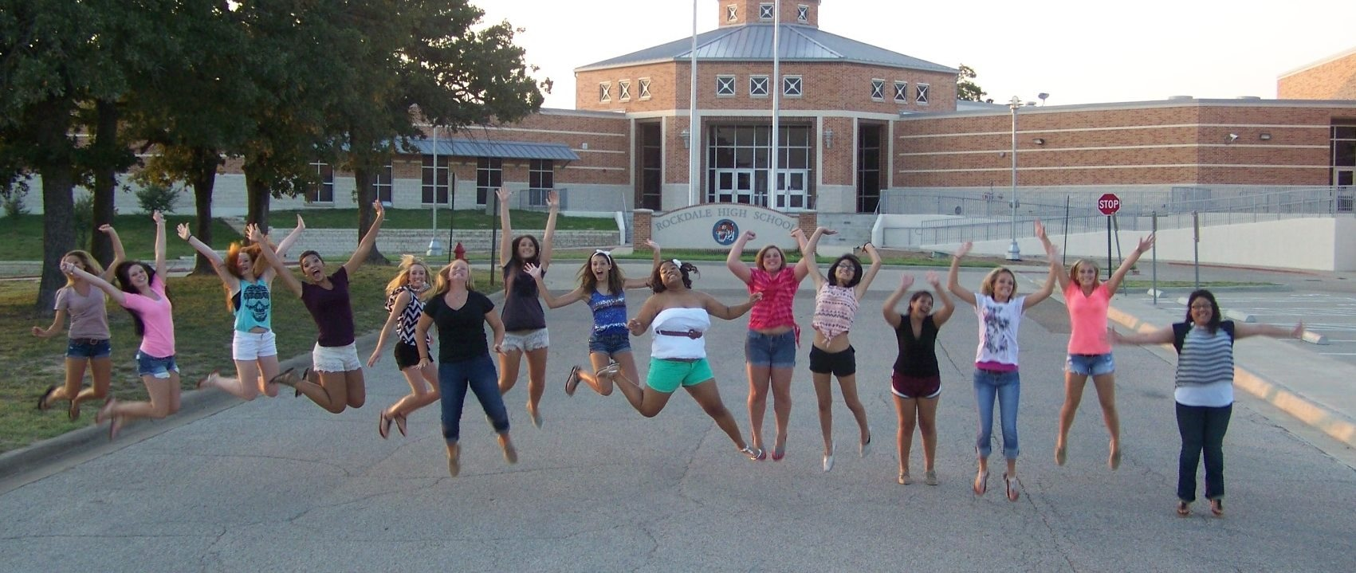
Mind Shift 3: Student Advocacy
Our students go to “college”!
Notes:
Survey stated that teachers did not believe all student can go on to college
Some teachers may still not believe all students can go to college.
Our students go to “college”!

Slide 49
What is College Readiness?
College readiness can be defined as the level of preparation necessary for students to enroll and succeed—without remediation—in entry-level, credit bearing, general education courses.
Source: Conley, D. T. (2007). Redefining College Readiness, volume 3. Eugene, OR: Educational Policy Improvement Center.
Notes:
Directions for Presenter: Italics
Information for Presenter to Convey: Bold
Presenter’s Notes:
Define college readiness. The slide shows a common, well accepted definition of what we mean when we say college readiness. What does college mean to your audience: certificate programs, technical schools, community colleges, traditional universities, post-graduate work? In Texas, it is understood that “college” means any further study past high school.
Source: Conley, D. T. (2007). Redefining College Readiness, volume 3. Eugene, OR: Educational Policy Improvement Center.

Slide 50
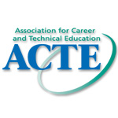
What is Career Readiness?
Career readiness involves three major skill areas:
core academic skills and the ability to apply those skills to concrete situations in order to function in the workplace and in routine daily activities;
employability skills (such as critical thinking and responsibility) that are essential in any career area;
technical, job-specific skills related to a specific career pathway. These skills have been emphasized across numerous pieces of research and allow students to enter true career pathways that offer family-sustaining wages and opportunities for advancement.
Copyright © 2012 Association for Career and Technical Education
Notes:
Directions for Presenter: Italics
Information for Presenter to Convey: Bold
Presenter’s Notes:
Define career readiness. The slide shows a common, well accepted definition of career readiness. The academic skills may be the same as college readiness; however, to be career ready, the student must demonstrate soft skills (employability skills) as well as some level of technical skill associated with job specific skills. For example, a pianist must know how to technically play the piano and these skills are identified through industry standards.
Source: www.acteonline.org

Slide 51
College and Career Readiness
Career Readiness
College Readiness
College & Career Readiness
Notes:
Directions for Presenter: Italics
Information for Presenter to Convey: Bold
Presenter’s Notes:
Demonstrate college readiness and career readiness as being strongly linked; success in an associates or certificate program often relies on the same set of entry level skills as success at a four-year institution. It was once desirable to say that college and career readiness was the same thing; however, our thinking has shifted to say that the academic skill attainment to engage in further studies and to obtain employment may be similar but for career readiness and success at further studies there are some specific needs that may be different. This is why this slide does not show the circles completely aligned.

Slide 52
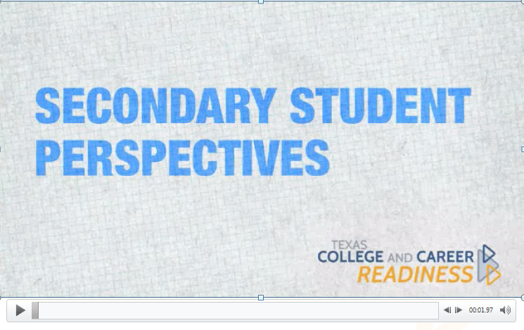
The Student Perspective http://txccrsc.org/master-trainer-portal/
Notes:
Directions for Presenter: Italics
Information for Presenter to Convey: Bold
Presenter’s Notes:
Participants will view a brief video presentation which provides a secondary student perspective for college and career readiness.
Various Texas middle school and high school students were interviewed for this video.

Slide 53
The Four Keys to College and Career Readiness
Based on the work of Dr. David Conley
Notes:
Directions for Presenter: Italics
Information for Presenter to Convey: Bold
Presenter’s Notes:

Slide 54
A Comprehensive Approach
College and career readiness is more than a cut score
Behaviors, contextual awareness, and thinking skills are all part of college and career readiness
A comprehensive approach can shape school practices and student behaviors
Conley, D. (2010). College and Career Ready. San Francisco: Jossey-Bass.
Notes:
Directions for Presenter: Italics
Information for Presenter to Convey: Bold
Presenter’s Notes:
Course titles, grade point averages, and test performance do not capture the full range of knowledge and skills students need to succeed in postsecondary learning

Slide 55
How do you
Key Cognitive Strategies
  Problem formulation, research, interpretation, communication,
  precision and accuracy
Key Content Knowledge
  Key terms & terminology, factual information, linking ideas, organizing concepts, academic and technical skills
Key Learning Skills & Techniques
  Time management, study skills, goal setting, self-awareness, persistence, collaborative learning, student ownership of learning, technological proficiency, retention of factual information
Key Transition Knowledge & Skills
  Postsecondary program selection, admissions requirements, financial aid,
  career pathways, postsecondary culture,
  role & identity issues, agency
THINK
What do you
KNOW
How do you
ACT
How do you
GO
55
Notes:
Directions for Presenter: Italics
Information for Presenter to Convey: Bold
Presenter’s Notes:
These four categories do no represent every thing a student needs (students obviously need a range of social and emotional supports to be successful) but they represent the dimensions in which a school can reasonably be expected to take action. They provide an excellent framework for thinking about college and career readiness comprehensively and are thus very useful common language for planning.
Those using this tool need to have a shared vision of college and career readiness.
For example, key cognitive strategies are essential to college and career readiness. Students must engage in problem formulation (Problem Based Instruction), research, communication, precision, and accuracy.

Slide 56
Texas College and Career Readiness Standards
Distinguished from high school graduation standards by emphasizing content as a means to an end; the content stimulates students’ deeper levels of thinking.
        Mandated by HB1
        Sponsored by TEA and THECB
        Developed by Vertical Teams
…more on this later…
Notes:
Directions for Presenter: Italics
Information for Presenter to Convey: Bold
Presenter’s Notes:
The Texas College Career Readiness Standards have been identified as the Key Content Knowledge target that schools should be teaching students. The Texas College Career Readiness Standards also engage thinking and technology skills, making them more comprehensive standards than have been used previously.
Texas College and Career Readiness Standards specifically addresses the four core and all disciplines in the cross-disciplinary standards.

Slide 57
Key Transition
Knowledge and Skills
We have a responsibility to ensure that all students have access to “college knowledge,” not just the students who seek it or already have it
Notes:
DIrections for Presenter: Italics
Information for Presenter to Convey: Bold
Presenter’s Notes:
Currently, we are very good at helping the kids who are motivated to go to college or careers. However, students who are unsure about their abilities, or have few role models, are less likely to seek assistance in applying or financing further studies. Students may also assume that high school courses they default into, due to scheduling issues, will be adequate to prepare them for further study and careers. This assumption is often not the case. Thus, counseling and scheduling decisions made for students entering high school can ultimately limit their long-term prospects. Texas schools must be more deliberate at meeting the individual needs of students, consider student interest and labor market trends to determine course offerings.

Slide 58
The Texas College and Career Readiness Standards
Sponsored by TEA and the THECB
Notes:
Directions for Presenter: Italics
Information for Presenter to Convey: Bold
Presenter’s Notes:

Slide 59

Texas College and Career Readiness Standards
College and Career Readiness Standards (CCRS) mandated by HB1
Sponsored by TEA and THECB
Presented to THECB – October 2007
Public comment period – October to December 2007
Adopted by THECB in Jan. 2008
Sent to the Commissioner of Education and State Board of Education for incorporation into the TEKS in April 2008
Notes:
Directions for Presenter: Italics
Information for Presenter to Convey: Bold
Presenter’s Notes:
Ask the audience how familiar they are with the standards.
How often do teachers use and refer to the TCCRS in planning, teaching, and discussions?

Slide 60
Texas College and Career Readiness Standards
The Texas College and Career Readiness Standards represent a full range of knowledge and skills that students need to succeed in college and careers.
Distinguished from high school graduation standards by emphasizing content as a means to an end
http://www.thecb.state.tx.us/index.cfm?objectid=BCA1DEF2-02B0-B3FB-5A72BD7F7FB2448E
Notes:
Directions for Presenter: Italics
Information for Presenter to Convey: Bold
Presenter’s Notes:
Implementing these standards will advance the mission of preparing college and career ready students.
The content stimulates students’ deeper levels of thinking rather than just being a list of facts to learn and forget.
Vertical teams set out to specify the knowledge and skills necessary to succeed in entry-level community college and university courses.
The Texas College Career Readiness Standards are distinguished from high school graduation standards by emphasizing content as a means to an end: the content stimulates students to engage in deeper levels of thinking.
Convergent consensus was employed for the initial drafting of the college readiness standards.
Timeline:
Public comment October-December 2007
Adopted by THECB in January 2008
Sent to the Commissioner of Education and State Board of Education for incorporation into the TEKS in April 2008

Slide 61
Development of the Texas College and Career Readiness Standards
TEA and the THECB convened vertical teams of secondary and postsecondary educators to develop the Standards
Notes:
Directions for Presenter: Italics
Information for Presenter to Convey: Bold
Presenter’s Notes:
These standards were created by secondary and postsecondary practitioners in collaboration with one another. This type of vertical collaboration has set the stage for implementation planning that includes components of the education system that have typically functioned in isolation.

Slide 62
Content of the Texas College and Career Readiness Standards
The Standards introduce disciplinary structures to familiarize students with key concepts and content in each of the core academic areas.
The Standards also include a set of cross-disciplinary standards that apply to all courses and subject areas.
Notes:
Directions for Presenter: Italics
Information for Presenter to Convey: Bold
Presenter’s Notes:
It is essential Texas schools understand the cross-disciplinary standards to create accountability with all educators.

Slide 63

Structure of the Texas College and Career Readiness Standards
1
Key Content
Organizing structure of the subject area
Content Area and Cross-Disciplinary standards organized in a hierarchical structure of 3 levels
2
Organizing Components
Conceptual topics
3
Performance Expectations
General goals & performance indicators*
Notes:
Directions for Presenter: Italics
Information for Presenter to Convey: Bold
Presenter’s Notes:
A notable feature of the Texas College and Career Readiness Standards is the inclusion of Cross-Disciplinary Standards.
Cross-Disciplinary Standards represent cognitive strategies and skills that span the subject areas and that instructors believe are critical to success in postsecondary education.
Cross-Disciplinary Standards should always be considered in the context of challenging content, and never be viewed as skills to be taught separate from appropriate content.
*Performance Indicators are not part of Texas CCRS, but included as possible examples of student performance.

Slide 64
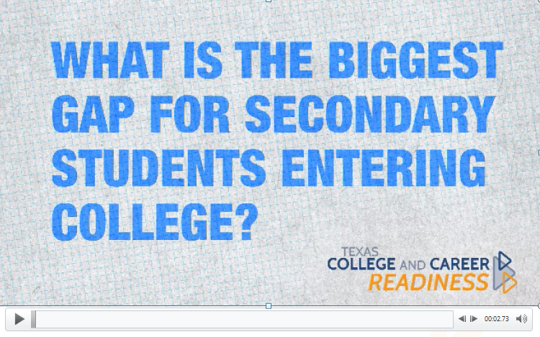
A Post-Secondary Perspective
Notes:
Directions for Presenter: Italics
Information for Presenter to Convey: Bold
Presenter’s Notes:
Participants will view the brief video presentation which provides a post-secondary perspective from current educators.
Mark Daniel, Clinical Professor, University of Texas at Austin
Kendall Dingee, Instructor, Austin Community College
Click on the video to launch “A Post-Secondary Perspective.”

Slide 65
How Can Schools Use the Cross-Disciplinary Standards?
Use as the focus of planning conversations within departments or with colleagues.
Explicitly share the standards with students at every opportunity.
    This practice contributes to a college-going and career-ready culture.
    This practice promotes self-awareness in students.
    This practice supports accurate self-assessment and goal-setting in students.
Notes:
Directions for Presenter: Italics
Information for Presenter to Convey: Bold
Presenter’s Notes:
Schools may put emphasis on encouraging teachers to collaborate about the cross disciplinary standards.
The idea is that simple alignment of the Texas College and Career Readiness Standards is not enough, teachers must put them into action in classrooms.

Slide 66
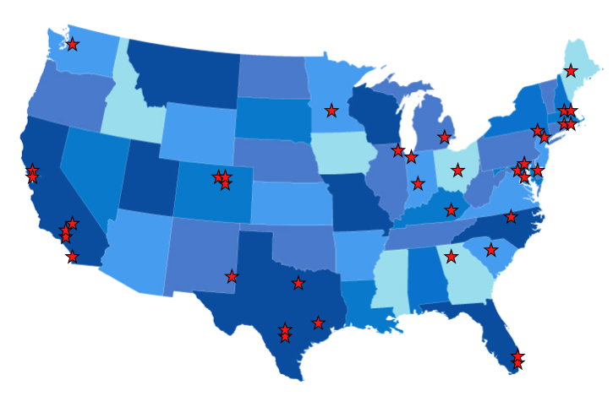
Seven Principles of College and Career Readiness
This was based on observations made in 38 schools that graduated a greater-than-expected proportion of their students who were college and career ready.
Notes:
Directions for Presenter: Italics
Information for Presenter to Convey: Bold
Presenter’s Notes:
Many of the goals in the Profile Planning Guide, particularly the Systems goals, are also based on seven research-based principles that create a college and career ready culture in schools.
The Texas College Career Profile Planning Guide and all 52 goals of the Guide are aligned to the Seven Principles of College and Career Readiness.

Slide 67
Seven Principles of College and Career Readiness
Create and maintain a college going culture in the school.
Create a core academic program aligned with college and career readiness
Teach key self-management skills and expect students to use them
Prepare students for the complexity of applying to college.
Align assignments and grading policies with college expectations
Make the senior year meaningful and challenging
Build partnerships and connections to postsecondary education
© 2012 Texas College & Career Readiness Center
Notes:
Directions for Presenter: Italics
Information for Presenter to Convey: Bold
Presenter’s Notes:
The purpose of the Texas College and Career Profile Planning Guide is to create a culture to support postsecondary options.

Slide 68
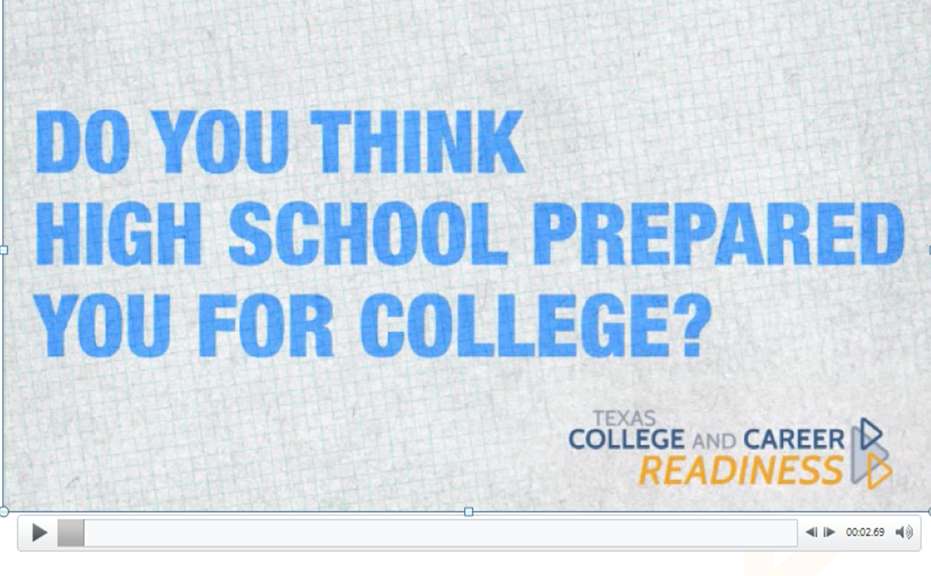
A Post-Secondary Student Perspective http://txccrsc.org/master-trainer-portal/
Notes:
Directions for Presenter: Italics
Information for Presenter to Convey: Bold
Presenter’s Notes:
Participants will view the brief video presentation which provides a student perspective after completing the first semester of Austin Community College.
Note there are many students in Texas schools that are served well by Texas counselors, this is our student perspective, however common or uncommon.
Click on the video to launch “A Post-Secondary Student Perspective.”

Slide 69

Gathering Data
A place to start…
Notes:
Directions for Presenter: Italics
Information for Presenter to Convey: Bold
Presenter’s Notes:
Schools are inundated with data. So much data that we often get lost in data. The following slides will assist with how to identify specific data that ties to developing a college and career ready culture in Texas schools.

Slide 70
SAT/ACT Data
Percentage of students taking SAT/ACT
Percentage of students meeting college Algebra/Calculus standards
Percentage of students with a composite score meeting these standards
Notes:
Directions for Presenter: Italics
Information for Presenter to Convey: Bold
Presenter’s Notes:
All schools are provided this information free of charge from these companies. An annual report is sent to the schools with this information. An ACT Concordance Table can be found online on the ACT website.

Slide 71
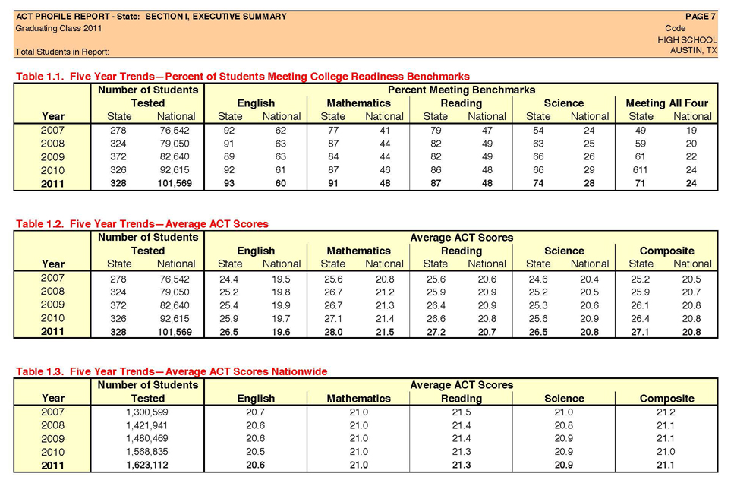
Notes:
Directions for Presenter: Italics
Information for Presenter to Convey: Bold
Presenter’s Notes:
ACT provides users with five year trends on the percentage of students meeting the college readiness benchmarks as well as the average ACT scores at your school and nationwide. Also included in a school’s report are gender and ethnicity breakdowns. Too often this information is kept in a file in the principal or counselor’s office and is not reviewed by the staff or leadership team.

Slide 72
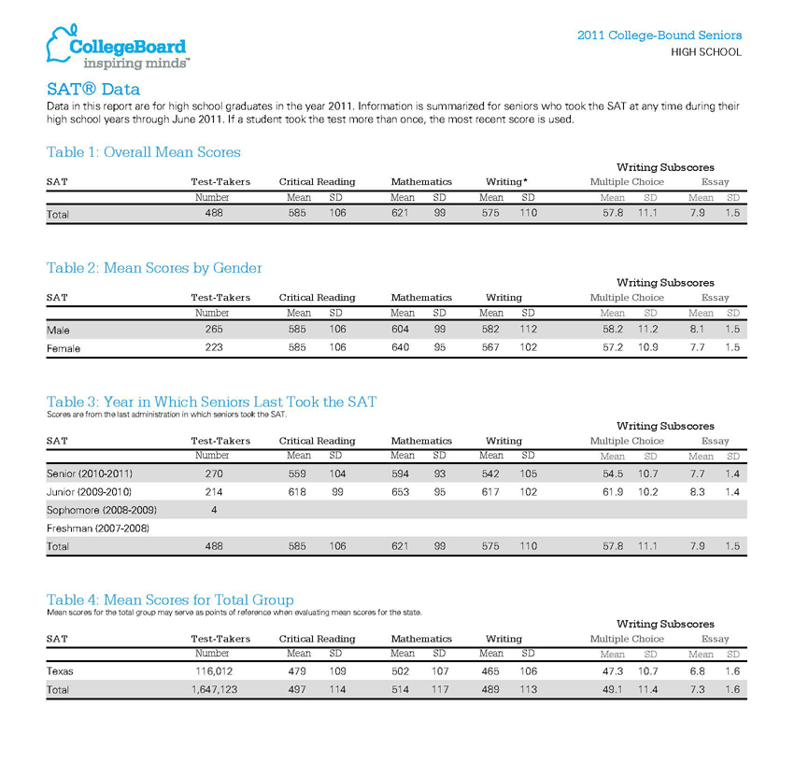
Notes:
Directions for Presenter: Italics
Information for Presenter to Convey: Bold
Presenter’s Notes:
The CollegeBoard also provides schools with valuable data on how students perform on the SAT. Table one gives your school’s data, table two breaks it down by gender, and table three breaks it down by grade level. You can also take your students Critical Reading and Mathematics scores and compare them to their ACT scores. A concordance table for the SAT and ACT can be found online. The data from the school shown has the mean SAT at 1206 and the mean ACT at 27.1. This is also what the concordance table predicts.
Source: www.collegeboard.org

Slide 73
Percentage of Students Taking Advanced Courses
Advanced Placement courses
International Baccalaureate courses
Dual Credit courses
Locally Articulated courses
Notes:
Directions for Presenter: Italics
Information for Presenter to Convey: Bold
Presenter’s Notes:
When looking at this data, it should also be broken down by population to get a more accurate picture of these programs.

Slide 74
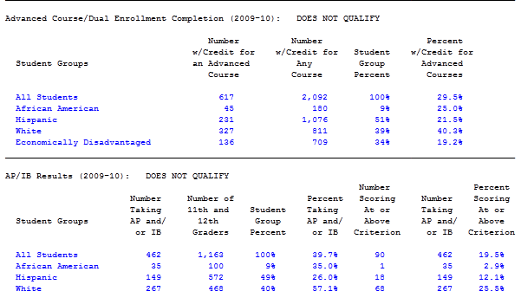
Percentage of Students Taking Advanced Courses
Notes:
Directions for Presenter: Italics
Information for Presenter to Convey: Bold
Presenter’s Notes:
This information comes directly from your school accountability report. This should mirror your population percentages. The top section are students who have been awarded credit for an advanced/dual enrollment course. The second circle represents the number of students taking AP/IB test, and the third circle gives you the percentage receiving a three or higher.

Slide 75
Graduation Plans
Distinguished Achievement Plan
Recommended Plan
Minimum High School Plan
and/or
Foundation
Foundation with Endorsement
Foundation Distinguished
Notes:
Directions for Presenter: Italics
Information for Presenter to Convey: Bold
Presenter’s Notes:
Percentage of students on specific graduation plans is important to analyze.

Slide 76
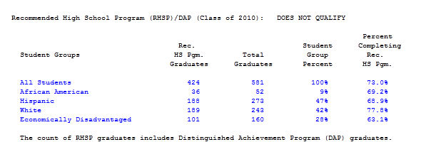
Graduation Plans
Notes:
Directions for Presenter: Italics
Information for Presenter to Convey: Bold
Presenter’s Notes:
Graduation Plans data comes directly from the TEA accountability report. If you look at the Hispanic and African American students, you will see that their Recommended/DAP rates are greater than 10% behind White students at this school. All of these groups need to be studied.
Once again, as you look at this collection of data, you should break it down by population to get a clear look at how your campus/district is performing.
Ex: If your population breakdown is 50% Hispanic, 30% Caucasian and 20% African American, you would want your graduation data to mirror that. In most schools this is not the case.
The same would hold true of your Eco. Disadvantage, SpEd and other populations. The intent is to match these up.

Slide 77
Completion Rates
Number of students enrolling in 9th grade compared to the number graduating four years later
Number of students enrolling in 6th grade and graduating seven years later
Notes:
Directions for Presenter: Italics
Information for Presenter to Convey: Bold
Presenter’s Notes:
Graduation rates tie directly to college and career readiness.

Slide 78
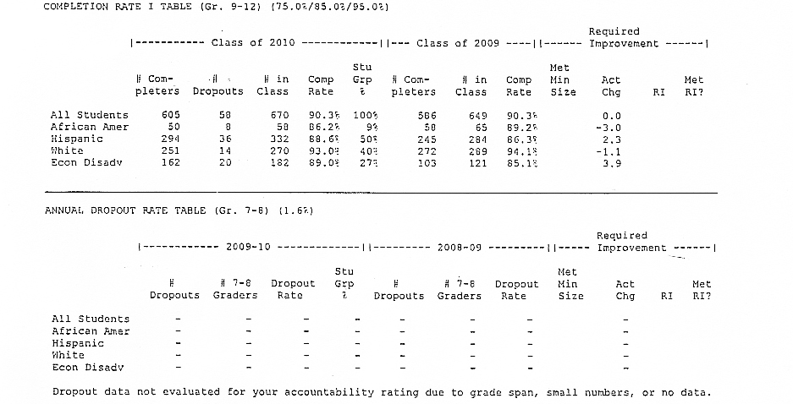
Completion Rates
Notes:
Directions for Presenter: Italics
Information for Presenter to Convey: Bold
Presenter’s Notes:
This is another example of information from the Accountability Report.
This will not include any students on the five year plan (i.e. the super seniors). Also, look at the indicator code for reason of withdrawal. If you have a high number of codes for homeschool or GED this also should be part of the data picture. If your district has access, look at the data for the entering sixth graders who should graduate this year. Most scheduling programs can run this report. In some cases it is called an “On Time” report.

Slide 79
State Assessments
TAKS Data
EOC/STAAR Data
Notes:
Directions for Presenter: Italics
Information for Presenter to Convey: Bold
Presenter’s Notes:
State data can be very tricky. Requirements for the THECB College Readiness Standards does not always meet certain colleges’ standards. Often students are placed in developmental classes that do not count toward graduation, and yet, student and parents are required to pay for them. In 2009, approximately 40% of Texas high school graduates enrolled in two-year, post-secondary institutions attended developmental classes.

Slide 80
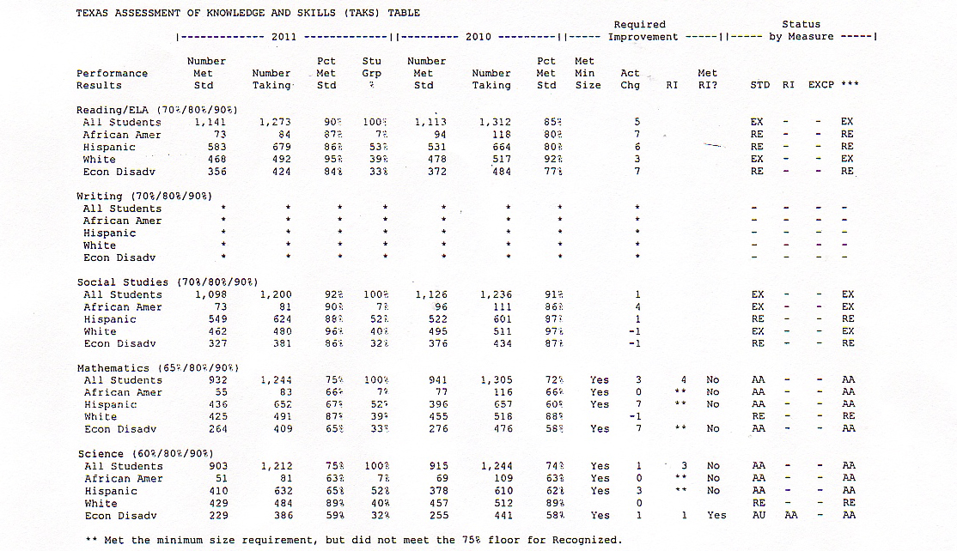
TAKS Assessment
Notes:
Directions for Presenter: Italics
Information for Presenter to Convey: Bold
Presenter’s Notes:
This is an example of a sample report sent to an ISD.

Slide 81
Higher Education
Percentage of last year’s seniors enrolled in a postsecondary school
Percentage of students placed in Developmental Education Classes
Percentage of this year’s seniors that have completed an ApplyTexas application
Notes:
Directions for Presenter: Italics
Information for Presenter to Convey: Bold
Presenter’s Notes:
This information can be obtained from the Texas Education Higher Education Board. Some postsecondary schools will have available a report on how your students did compared to the rest of the post-secondary school’s population.
Click on percentage and it will take you directly to the THECB site. You can look at any school and know exactly where their students enrolled in a postsecondary school.
Talk about out of state students.
Does your school send students out of state?

Slide 82
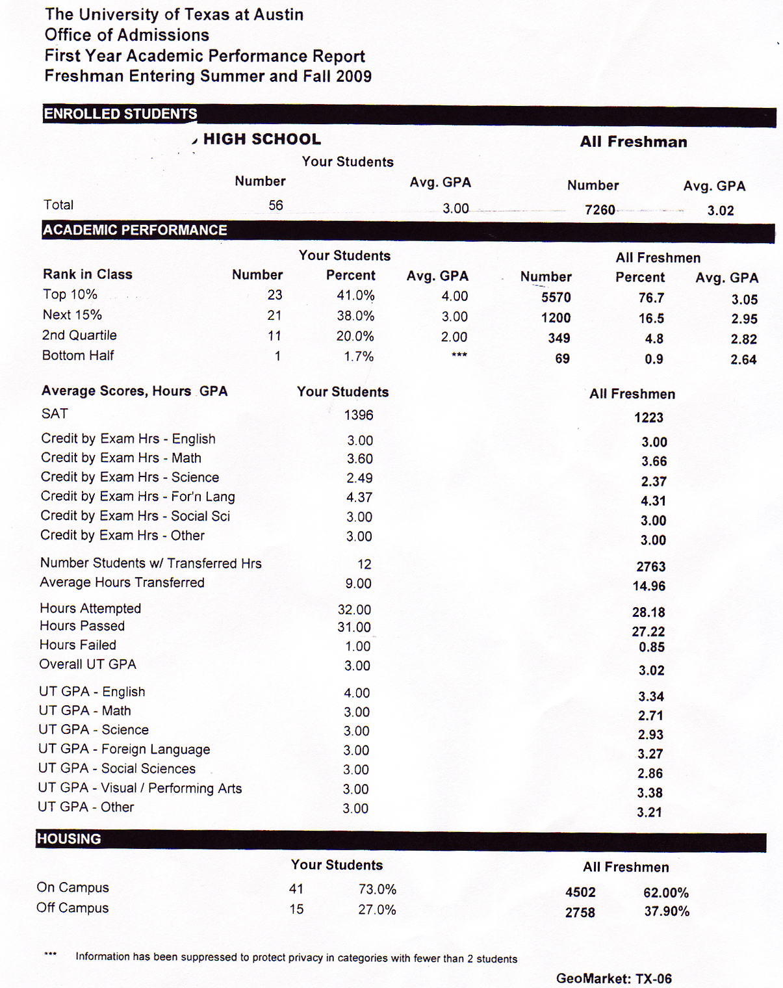
Notes:
Directions for Presenter: Italics
Information for Presenter to Convey: Bold
Presenter’s Notes:
Report cards like this example from the University of Texas show you how your students are doing compared to all freshmen on the post-secondary campus. The students at this high school performed very well overall, but they did not perform as well as all freshmen in the area of foreign languages. This is an example of more information that could be shared with disciplines.
Source: www.applytexas.com

Slide 83
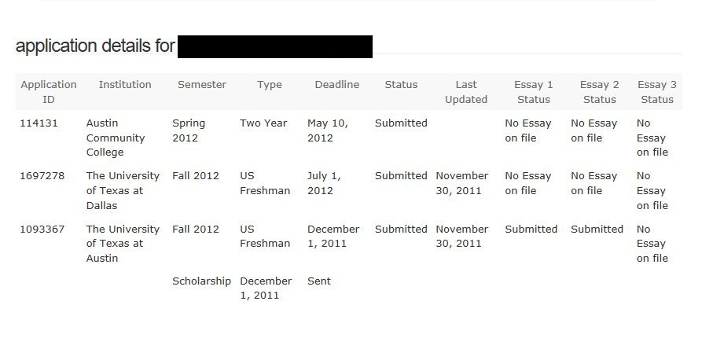
ApplyTexas
Counselor Suite
*******
*******
*******
Notes:
Directions for Presenter: Italics
Information for Presenter to Convey: Bold
Presenter’s Notes:
The ApplyTexas Counselor Suite is a great tool for a school to track a student’s college application process. In this example, the student submitted the application for the University of Texas at Dallas, but the application was incomplete because the essay requirement was not included. The application for the University of Texas is complete because the student met the requirements for Essay 1 and 2.
Source: www.applytexas.com

Slide 84
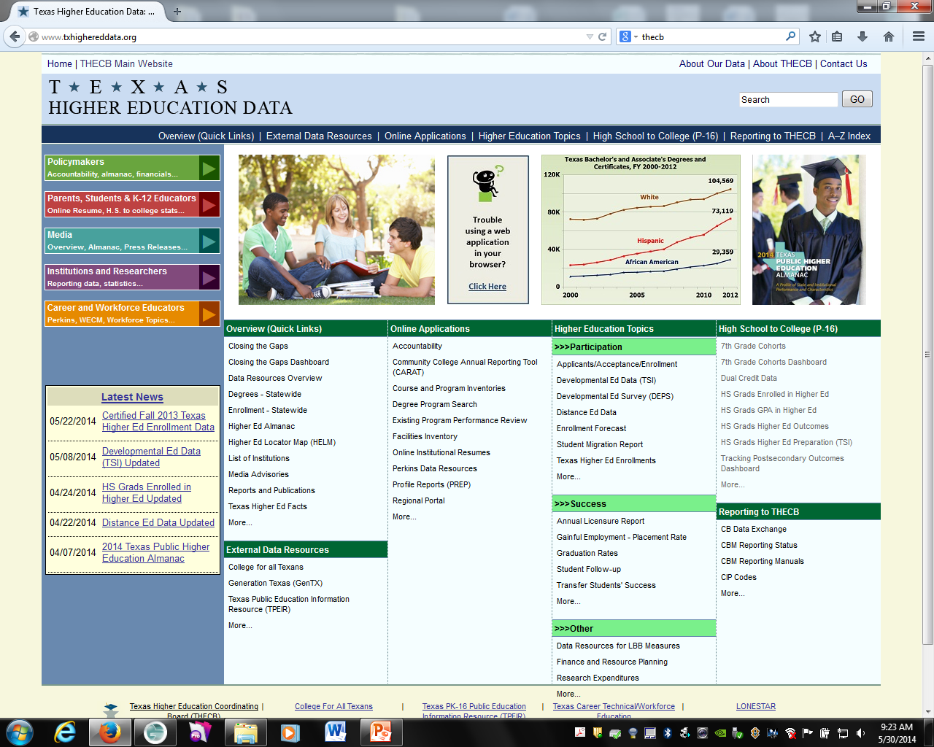

Slide 85
Career
CTE course taking patterns
Labor market data
Student career interest inventory
Notes:
Directions for Presenter: Italics
Information for Presenter to Convey: Bold
Presenter’s Notes:
What percentage of students are taking career technical courses? Once again, break it down by population. Look at your labor market profile. Identify high skills/high wage/high demand occupations. High Skill refers to technical skill attainment in some level of further study after high school. High wage in Texas has currently been identified at $15.14/hour. High demand occupations can be found though multiple free workforce development sites. Compare this to your course offerings. What percent of students participate in a program of study? What programs of study do you offer at your school?

Slide 86
















16 Career Clusters
Notes:
Directions for Presenter: Italics
Information for Presenter to Convey: Bold
Presenter’s Notes:
The United States Department of Education Career Clusters are used to simply organize curriculum and occupations. All occupations and all curriculum tied to common knowledge and skills may be organized under one, or more, of these 16 clusters.
86

Slide 87
Labor Market Data
Texas Workforce Commission
SOCRATES:
  Select Regional Occupational Evaluation
  Select Region
  Select desired weight for each criteria
  Filter by wage (at least $15.14/hour to $9999/hour
  Filter by education (any education attainment past high school; use Ctrl to select multiple)
  Perform Occupational Evaluation
Notes:
Directions for Presenter: Italics
Information for Presenter to Convey: Bold
Presenter’s Notes:
The Texas Workforce Commission offers a free tool that can be used to sort regional occupations into high skill, high wage, high demand occupations to facilitate effective decision making on your campus.
High demand occupations may be found through multiple, free workforce development sites. However, we need to narrow the data to include only high skill, high wage, and high demand occupations.

Slide 88
Notes:
Directions for Presenter: Italics
Information for Presenter to Convey: Bold
Presenter’s Notes:
The results of this type of analysis can be aligned to the USDE career clusters.

Slide 89
Notes:
Directions for Presenter: Italics
Information for Presenter to Convey: Bold
Presenter’s Notes:
Schools have access to multiple systems that can facilitate a valid, reliable, career assessment. Note that school surveys are not accurate at determining student interest.
Many systems are used in Texas: Career Cruising, Kuder, Bridges, COIN, etc.
Have audience name other systems they may used in their schools.
Student interest can be sorted and tied to USDE career clusters.

Slide 90
Notes:
Directions for Presenter: Italics
Information for Presenter to Convey: Bold
Presenter’s Notes:
It is important to see where resources are being allocated. An analysis to current CTE course offerings may be a way to determine the best use of resources.

Slide 91
Example
Notes:
Directions for Presenter: Italics
Information for Presenter to Convey: Bold
Presenter’s Notes:
When career information is tied together, we can see the alignment of student interest, labor market information, and the current use of resources. This is important data to discuss for appropriate shifts in programming to meet the needs of your students and community. This data should drive course offerings. Historically, many school have offered courses based on prior student participation or adult perception that often does not meet current needs. How can we build a college and career culture if we are not using valid career data?

Slide 92

Given What You Know…
…how receptive do you think your campus/leaders will be to the concept of Building a College and Career Foundation?
Think-Pair-Share
Notes:
Directions for Presenter: Italics
Information for Presenter to Convey: Bold
Presenter’s Notes:
Check in with your audience and talk about points of resistance. What might be some strategies for overcoming these points?
The purpose of this slide it to determine if there is a lack of common, unified understanding about college and career readiness.

Slide 93
Shauna Lane, Counselor Solutions
slane@esc17.net
Heather Blount, CTE
hblount@esc17.net

